Slide 1
M&C Program Reporting Process
July 2013

Slide 2
Purpose of Reporting
Increase awareness of the use of standard templates
Ensure understanding of program reporting inputs/outputs
Regular Summary indicating Project/Program health
Ability to summarise progress by date
Highlight key RAID items for Management attention
Ensure Execs and Sponsors gain a snapshot of program status
Enable the business to make informed decisions
Allow metrics to be provided which highlight common challenges
Demonstrate that the project/program is being controlled
Ensure quality and consist reporting across all programs
July 2013

Slide 3
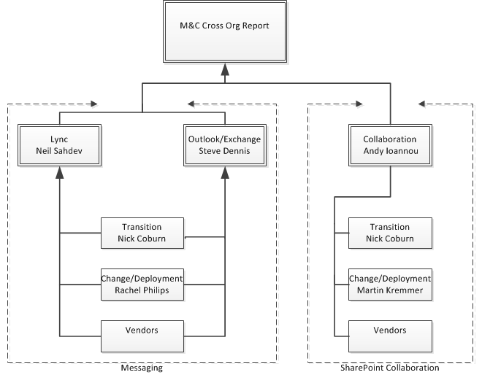
Reporting Types
Program IT Services IT PM Tool report
  4 reports are required to be submitted fortnightly on to Cross Org PMO, Program workstream listed below.
    Messaging Lync.
    Messaging Outlook/Exchange.
    Collaboration Release 1.
    Collaboration Release 2.
M&C Sub-Program health report.
    This is a weekly workstream Sub-report dashboard extract from the IT PM Tool report. It is a RAG snapshot of the status of each individual program summary of the program delivery lifecycle stages.
Monthly Exec report.
    This is a monthly report produced by workstream Leads for Program Sponsors and Executives. There is currently no specific cycle for this report.
Fortnightly IT PM
Tool Reports
Weekly Program
Sub-report

Slide 4
  M&C PM Reporting Responsibilities
  PM’s are required to complete the IT PM Tool reports fortnightly using the standard IT Services Template
  PM’s are also required to complete the weekly Sub-Program Report using the standard PMO project lifecycle template.
  PM’s are required to represent dependant workstream program statuses in all their reports e.g. Transition, Change and Deployment.
  PM’s are require to attend the fortnightly QA session, where the reports are reviewed an
  PM’s are required to attend the weekly Program Management meeting to present /defend their workstream statuses reports.
Day | Monday | Tuesday | Wednesday | Thursday | Friday
Reports |  | PM’s submit reports to Workstream Leads. (Weekly) | Workstream Leads review and consolidate status reports. (Weekly) | Workstream Leads/PM’s Submit Program Status Reports & Workstream Sub-report (Weekly, 3pm) | Complete Exec level report pack. (Ad-Hoc only as requested)
Meetings |  | Attend M&C Program Management Meeting (Weekly, 1pm) |  |  | PMO Fortnightly QA Review (Involves a different PM for every session (Fortnightly 10am)
Feedback | QA Report feedback to PM’s (Fortnightly, All day)
July 2013

Slide 5
Appendix 1: Program Report Links

Slide 6
Report Links
Standard ITS reporting template
Standard M&C Sub-Report health report template.
PMO RAG guidance.
Exec pack
M&C reporting cadence
July 2013

Slide 7
Thank you

